Slide 1

CSE-4078 Mobile Application Development
Lecture 10 and 11
Sara Masood

Slide 2

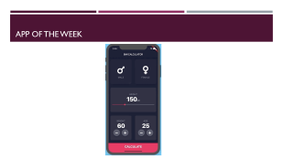


outline

Slide 3
App of the week

Slide 4
Colors in Flutter

Slide 5
Material colors
Color and ColorSwatch constants which represent Material design's color palette.
Colors class - material library - Dart API (flutter.dev)
Color selection = Colors.green[400]!; // Selects a mid-range green.

Slide 6
Custom Colors
An immutable 32 bit color value in ARGB format.
Color c = const Color(0xFF42A5F5);
Color c = const Color.fromARGB(0xFF, 0x42, 0xA5, 0xF5);
Color c = const Color.fromARGB(255, 66, 165, 245);
Color c = const Color.fromRGBO(66, 165, 245, 1.0);

Slide 7
Themes

Slide 8
Flutter themes
Use themes to share colors and font styles throughout an app.
App-wide themes and Theme widgets that define the colors and font styles for a particular part
App-wide themes are just Theme widgets created at the root of an app by the MaterialApp
Use themes to share colors and font styles | Flutter

Slide 9
Dark theme
MaterialApp(
title: ‘Dark theme Demo',
theme: ThemeData.dark(),

Slide 10
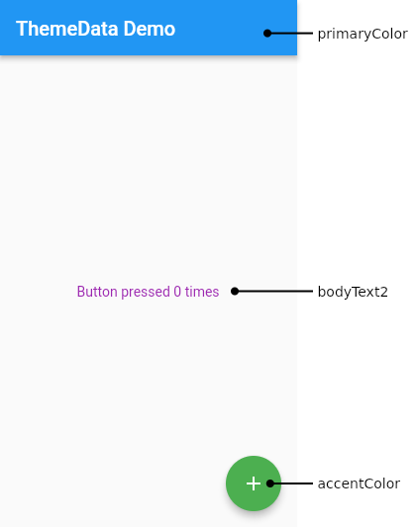
Creating an app theme
To share a Theme across an entire app, provide a ThemeData to the MaterialApp constructor.
If no theme is provided, Flutter creates a default theme for you.
ThemeData class - material library - Dart API (flutter.dev)

Slide 11
Creating an app theme - implementation
MaterialApp(
title: appName,
theme: ThemeData(
// Define the default brightness and colors.
brightness: Brightness.dark,
primaryColor: Colors.lightBlue[800],
// Define the default font family.
fontFamily: 'Georgia’,
// Use this to specify the default text styling for headlines, titles, bodies of text, and more.
textTheme: const TextTheme(
headline1: TextStyle(fontSize: 72.0, fontWeight: FontWeight.bold),
headline6: TextStyle(fontSize: 36.0, fontStyle: FontStyle.italic),
bodyText2: TextStyle(fontSize: 14.0, fontFamily: 'Hind'),
),),);

Slide 12
Extending the parent theme
Rather than overriding everything, it often makes sense to extend the parent theme.
You can handle this by using the copyWith() method.
Theme(
data: Theme.of(context).copyWith(splashColor: Colors.yellow),
child: const FloatingActionButton(
onPressed: null,
child: Icon(Icons.add),
),);

Slide 13
Themes for part of an application
To override the app-wide theme in part of an application, wrap a section of the app in a Theme widget.
There are two ways to approach this
creating a unique ThemeData
extending the parent theme.

Slide 14
Themes for part of an application - creating a unique ThemeData
Theme(
// Create a unique theme with `ThemeData`
data: ThemeData(
splashColor: Colors.yellow,
),
child: FloatingActionButton(
onPressed: () {},
child: const Icon(Icons.add),
),
);

Slide 15
Themes for part of an application - Extending the parent theme
Theme(
// Find and extend the parent theme using `copyWith`. See the next
// section for more info on `Theme.of`.
data: Theme.of(context).copyWith(splashColor: Colors.yellow),
child: const FloatingActionButton(
onPressed: null,
child: Icon(Icons.add),
),
);

Slide 16
Using a Theme
Now that you’ve defined a theme, use it within the widgets’ build() methods by using the Theme.of(context) method.
The Theme.of(context) method looks up the widget tree and returns the nearest Theme in the tree.
If you have a standalone Theme defined above your widget, that’s returned.
If not, the app’s theme is returned.
Container(
color: Theme.of(context).colorScheme.secondary,
child: Text(
'Text with a background color',
style: Theme.of(context).textTheme.headline6,
),),

Slide 17
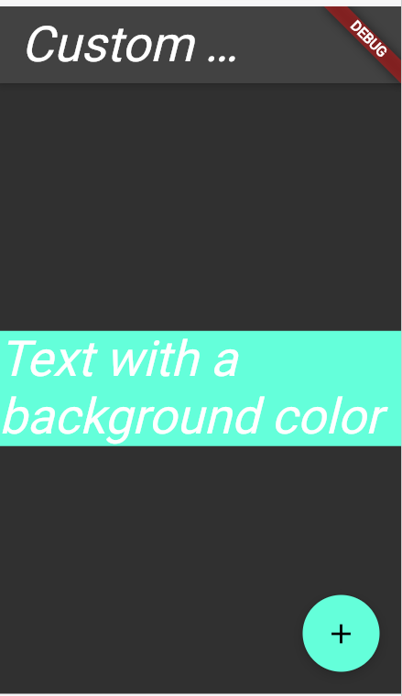
Interactive example
Use themes to share colors and font styles | Flutter

Slide 18
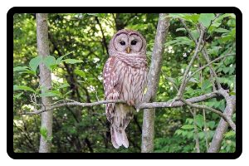
BoxDecoration
The BoxDecoration class provides a variety of ways to draw a box.
Container(
decoration: BoxDecoration(
color: const Color(0xff7c94b6),
image: const DecorationImage(
image: NetworkImage('https://flutter.github.io/assets-for-api-docs/assets/widgets/owl-2.jpg'),
fit: BoxFit.cover,
),
border: Border.all(
color: Colors.black,
width: 8,
),
borderRadius: BorderRadius.circular(12),
),
)

Slide 19
BoxDecoration
The BoxDecoration class provides a variety of ways to draw a box.
BoxDecoration class - painting library - Dart API (flutter.dev)
Container(
decoration: BoxDecoration(
color: const Color(0xff7c94b6),
image: const DecorationImage(
image: NetworkImage('https:/…/owl-2.jpg'),
fit: BoxFit.cover,
),
border: Border.all(
color: Colors.black,
width: 8,
),
borderRadius: BorderRadius.circular(12),),)

Slide 20
resources

Slide 21
Useful resources
Cookbook | Flutter
Dribbble - Discover the World’s Top Designers & Creative Professionals

